Slide 1
Data Structures and Algorithms Lecture 6: Bubble Sort , Insertion Sort and Merge Sort
Data Science
United International College

Slide 2
Outline
Motivation
Bubble Sort (冒泡排序)
Insertion Sort (插入排序)
Merge Sort (归并排序)
Divide and Conquer (分治法)

Slide 3
Motivation
How do you quickly find
Your name in a name list?
A book on a shelf?
A word in a dictionary?
Sort them beforehand!

Slide 4
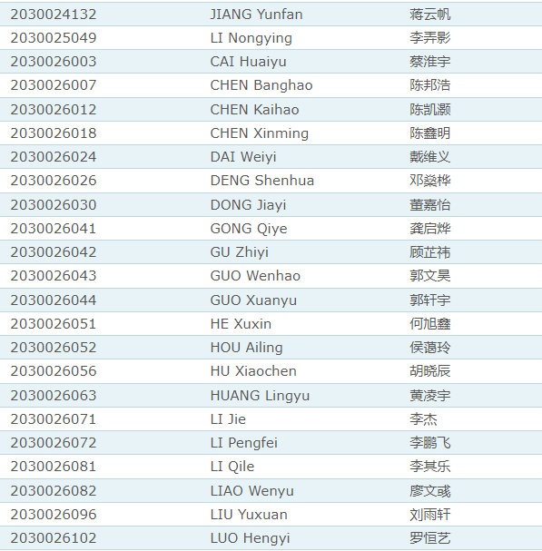


Motivation
How do you quickly find
Your name in a name list?
A book on a shelf?
A word in a dictionary?

Slide 5
Visualization
Visualization and Comparison of Sorting Algorithms
Algorithms used:
Selection Sort | Shell Sort | Insertion Sort
Merge Sort | Quick Sort | Heap Sort
Bubble Sort | Comb Sort | Cocktail Sort
Notes:
Selection sort i

Slide 6
Bubble Sort
Is the simplest sorting algorithm, which works by repeatedly swapping of adjacent elements if they are in wrong order. For an array, we want to have an increasing order!
Given following elements:
13 | 32 | 26 | 35 | 10
First pass:
13 | 32 | 26 | 35 | 10
13 < 32, order is correct.
13 | 32 | 26 | 35 | 10
32 > 26, order is incorrect, swap!
13 | 26 | 32 | 35 | 10
13 | 26 | 32 | 35 | 10
32 < 35, order is correct.
13 | 26 | 32 | 35 | 10
35 > 10, order is incorrect, swap!
13 | 26 | 32 | 10 | 35
13 | 26 | 32 | 10 | 35
Largest element goes to the last position!

Slide 7
Bubble Sort
Is the simplest sorting algorithm, that works by repeatedly swapping of adjacent elements if they are in wrong order.
Given following elements:
13 | 32 | 26 | 35 | 10
Second pass:
13 | 26 | 32 | 10 | 35
13 < 26, order is correct.
13 | 26 | 32 | 10 | 35
26 < 32, order is correct.
13 | 26 | 32 | 10 | 35
32 > 10, order is incorrect, swap!
13 | 26 | 10 | 32 | 35
13 | 26 | 10 | 32 | 35
Second largest element goes to 2nd last position!
Notes:
In each pass,
Move from the front to the end
“Bubble” the largest value to the end using pair-wise comparisons and swapping

Slide 8

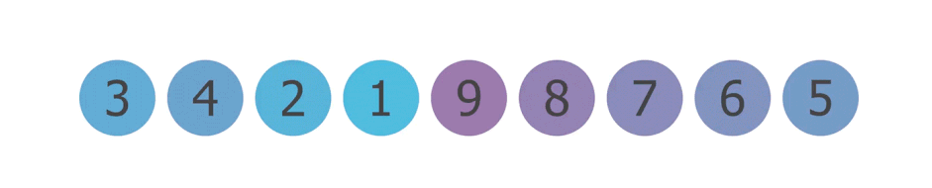
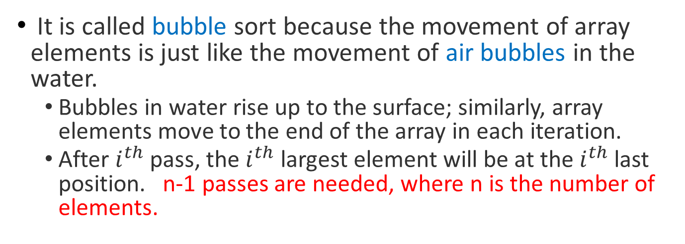
Bubble Sort
It is called bubble sort because the movement of array elements is just like the movement of air bubbles in the water.
Bubbles in water rise up to the surface; similarly, array elements move to the end of the array in each iteration.
After $i^{th}$ pass, the $i^{th}$ largest element will be at the $i^{th}$ last position. n-1 passes are needed, where n is the number of elements.

Slide 9
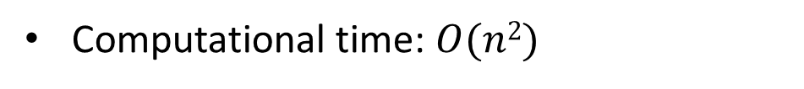
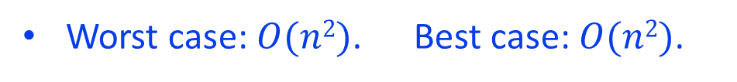
Pseudo Code for Bubble Sort: inefficient implementation
Bubble-SORT(A) // A is a pointer 1. FOR i = 0 TO n-2 2. FOR j=0 TO n-i-2 3. If A[j+1] < A[j]
swap A[j] and A[j+1]
end If
end For
end For
Computational time: $O(n2)$
Worst case: $O(n2)$. Best case: $O(n2)$.
Notes:
In each iteration:
Move from the front to the end
“Bubble” the largest value to the end using pair-wise comparisons and swapping
Worst case: O(n^2)
Best case: O(n^2)
Average case: one has about half as many exchange operations as in the worst case since about half of the elements are in the correct position compared to the neighboring element.

Slide 10

Pseudo Code for Bubble Sort: efficient implementation
Bubble-SORT-OPT(A) // A is a pointer 1. FOR i = 0 TO n-2
2. flag = false 3. FOR j=0 TO n-i-2 4. If A[j+1] < A[j]
5. swap A[j] and A[j+1]
6. flag = true
7. IF flag is false
8. break;
Computational time: $O(n2)$
Worst case: $O(n2)$. Best case: $O(n)$.
Notes:
In each iteration:
Move from the front to the end
“Bubble” the largest value to the end using pair-wise comparisons and swapping
Worst case: O(n^2)
Best case: O(n)
Average case: one has about half as many exchange operations as in the worst case since about half of the elements are in the correct position compared to the neighboring element.

Slide 11

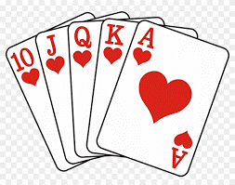
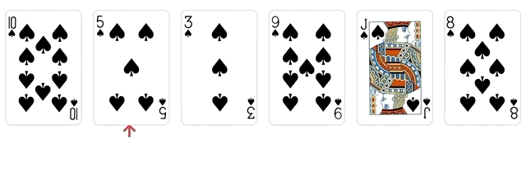
Sorting Poker Cards

Slide 12
Insertion Sort
A sorting algorithm that works similar to the way you sort playing cards in your hands.
The array is virtually split into a sorted and an unsorted part. Values from the unsorted part are picked and placed at the correct position in the sorted part.
Incremental algorithm (递增式算法), sorted part is growing after each iteration.
10 | 35 | 13 | 26 | 42 | 16
10 | 13 | 35 | 26 | 42 | 16
Sorted
Unsorted
Sorted
Unsorted

Slide 13
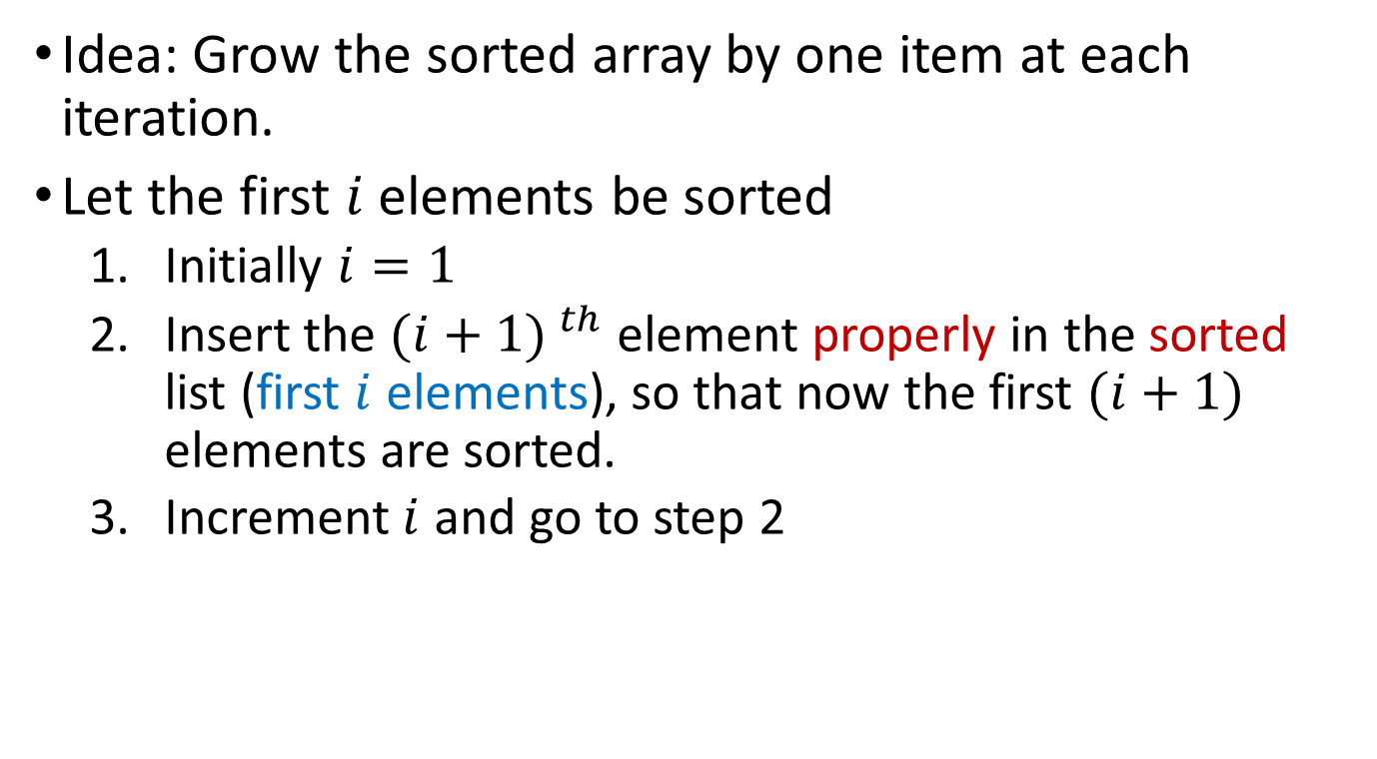
Insertion Sort
Idea: Grow the sorted array by one item at each iteration.
Let the first $i$ elements be sorted
Initially $i=1$
Insert the ${(i+1) }^{th}$ element properly in the sorted list (first $i$ elements), so that now the first $(i+1)$ elements are sorted.
Increment $i$ and go to step 2

Slide 14
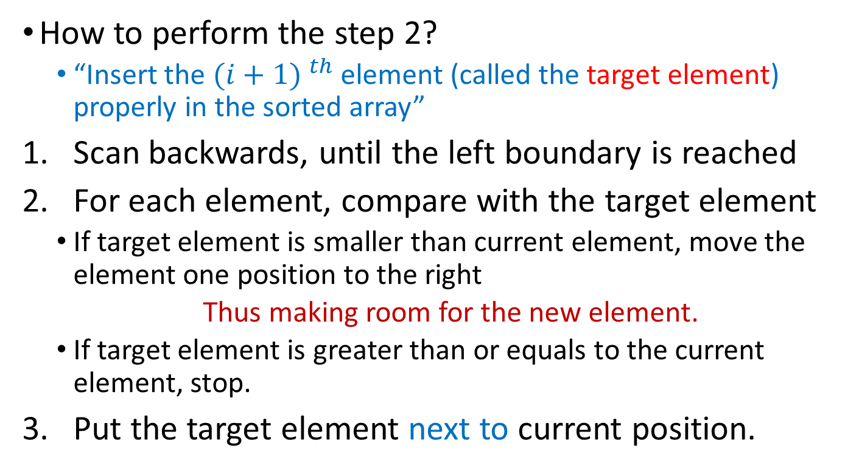
How is insertion Done?
How to perform the step 2?
“Insert the ${(i+1) }^{th}$ element (called the target element) properly in the sorted array”
Scan backwards, until the left boundary is reached
For each element, compare with the target element
If target element is smaller than current element, move the element one position to the right
Thus making room for the new element.
If target element is greater than or equals to the current element, stop.
Put the target element next to current position.

Slide 15

Insertion Sort - Example
Input array:
35 | 10 | 13 | 26 | 42 | 16
For $i=1$, insert the 2nd element:
10
35 | 10 | 13 | 26 | 42 | 16
35 | 35 | 13 | 26 | 42 | 16
10 | 35 | 13 | 26 | 42 | 16
10 | 35 | 13 | 26 | 42 | 16

Slide 16

Insertion Sort - Example
Current array:
10 | 35 | 13 | 26 | 42 | 16
For $i=2$, insert the 3rd element:
13
10 | 35 | 13 | 26 | 42 | 16
10 | 35 | 35 | 26 | 42 | 16
10 | 13 | 35 | 26 | 42 | 16
10 | 13 | 35 | 26 | 42 | 16

Slide 17

Insertion Sort - Example
Current array:
10 | 13 | 35 | 26 | 42 | 16
For $i=3$, insert the 4th element:
26
10 | 13 | 35 | 26 | 42 | 16
10 | 13 | 35 | 35 | 42 | 16
10 | 13 | 26 | 35 | 42 | 16
10 | 13 | 26 | 35 | 42 | 16

Slide 18

Insertion Sort - Example
Current array:
10 | 13 | 26 | 35 | 42 | 16
For $i=4$, insert the 5th element:
42
10 | 13 | 26 | 35 | 42 | 16
10 | 13 | 26 | 35 | 42 | 16
10 | 13 | 26 | 35 | 42 | 16

Slide 19

Insertion Sort - Example
For $i=5$, insert the 6th element:
16
10 | 13 | 26 | 35 | 42 | 16
10 | 13 | 26 | 35 | 42 | 42
10 | 13 | 26 | 35 | 35 | 42
10 | 13 | 26 | 26 | 35 | 42
10 | 13 | 16 | 26 | 35 | 42
10 | 13 | 16 | 26 | 35 | 42

Slide 20
Pseudo Code for Insertion Sort
INSERTION-SORT(A) 1. FOR k = 1 TO n-1 2. key = A [k] 3. i = k – 1 4. WHILE i >= 0 AND A[i] > key 5. A[i+1] = A[i] 6. i = i – 1
7. END WHILE 8. A[i+1] = key // The index is i+1
9. END FOR
Notes:
The stop condition for while i>=0 && A[i]>key is (1) i<0 or (2) A[i]<=key.
For the case (1) i<0, we have i=0-1=-1, and A[0]>key, so A[1] = A[0], and A[0] = key
For case (2): A[i]<=key, then A[i+1] = key

Slide 21
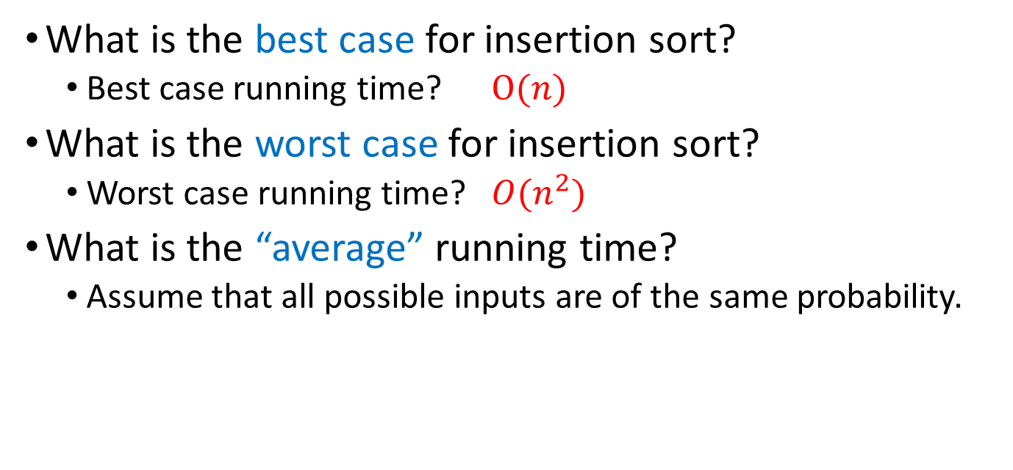
Discussion
What is the best case for insertion sort?
Best case running time? $O(n)$
What is the worst case for insertion sort?
Worst case running time? ${O(n}^{2})$
What is the “average” running time?
Assume that all possible inputs are of the same probability.
Notes:
best case: already sorted, for every element , compare leftwards and stop. Compare once, #comparisions: O(n)
worst case: reversed sorted, for every element, has continue comparison until reaching the left end. # comparisions: 1+2+...+n-1 = O(n^2)
average case: for the p^th element, on average, we expect half of the elements to its left are greater than this element, therefore, if the left length is k, k/2 comparisons. #comparisons: ½(1+2+...+n-1) = O(n^2)

Slide 22
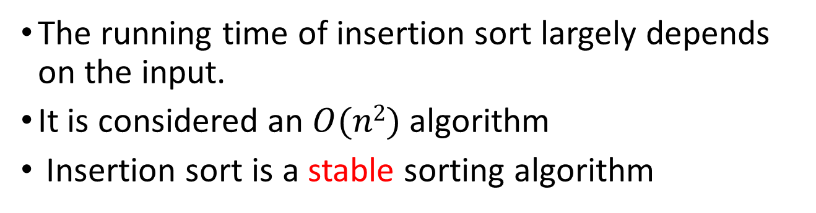
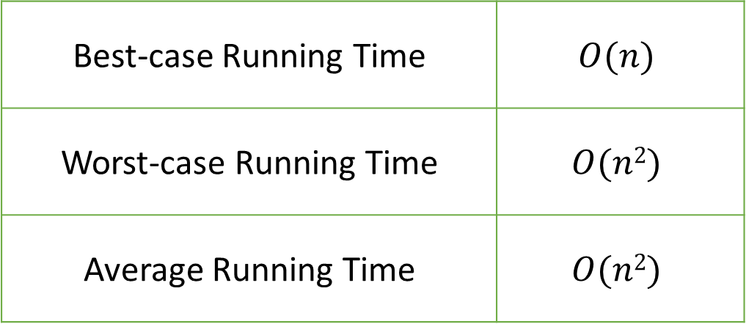
Analysis of Insertion Sort
Best-case Running Time | $$O(n)$$
Worst-case Running Time | $$O(n2)$$
Average Running Time | $$O(n2)$$
The running time of insertion sort largely depends on the input.
It is considered an $O(n2)$ algorithm
Insertion sort is a stable sorting algorithm
Notes:
A sorting algorithm is said to be stable if two objects with equal or same keys appear in the same order in sorted output as they appear in the input array to be sorted.
Insertion sort is a stable sorting algorithm.

Slide 23
Merge Sort (归并排序) (By Von. Neumann, 1945)
Idea: divide and conquer (分治法)
Algorithm:
Divide the list into two smaller lists of about equal size
Sort each smaller list recursively
Merge the two sorted lists to get one sorted list

Slide 24
Merge Sort
35 | 10 | 13 | 26 | 42 | 16
Divide (Split)
35 | 10 | 13
26 | 42 | 16
Conquer
…....
…....
10 | 13 | 35
16 | 26 | 42
Combine (Merge)
10 | 13 | 16 | 26 | 35 | 42

Slide 25
Questions to Ponder
How do we divide the list?
How much time is needed for this divide operation?
How do we merge the two sorted lists?
How much time is needed for the merge operation?

Slide 26
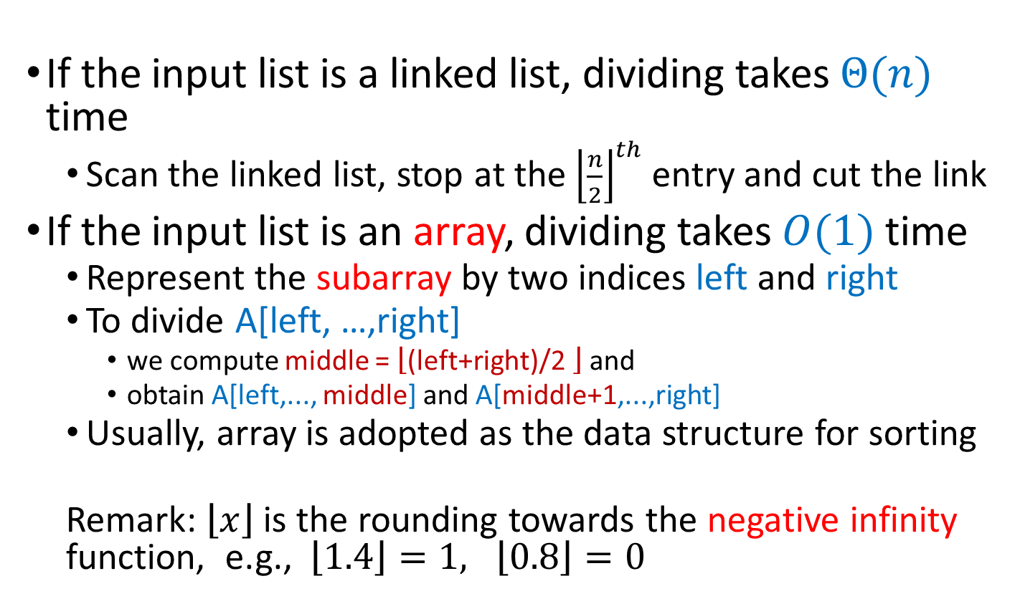
Dividing
If the input list is a linked list, dividing takes $Θ(n)$ time
Scan the linked list, stop at the ${\left\lfloor \frac{n}{2}\right\rfloor }^{th}$ entry and cut the link
If the input list is an array, dividing takes $O(1)$ time
Represent the subarray by two indices left and right
To divide A[left, …,right]
we compute middle = $\left\lfloor \text{(}\text{left}\text{+}\text{right}\text{)/2 }\right\rfloor$ and
obtain A[left,..., middle] and A[middle+1,...,right]
Usually, array is adopted as the data structure for sorting
Remark: $\left\lfloor x\right\rfloor$ is the rounding towards the negative infinity function, e.g., $\left\lfloor 1.4\right\rfloor =1, \left\lfloor 0.8\right\rfloor =0$

Slide 27
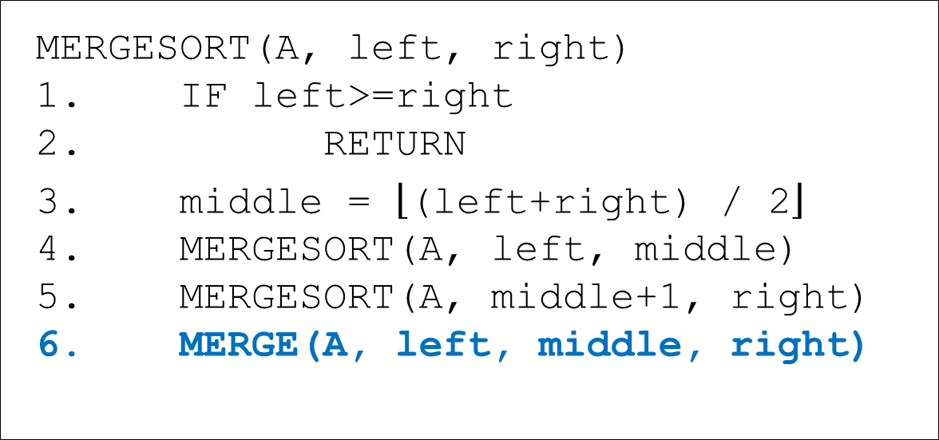
Pseudo Code for Merge Sort
MERGESORT(A, left, right) 1. IF left>=right 2. RETURN
3. middle = $\left\lfloor \text{(}\text{left}\text{+}\text{right}\text{) / 2}\right\rfloor$ 4. MERGESORT(A, left, middle) 5. MERGESORT(A, middle+1, right) 6. MERGE(A, left, middle, right)

Slide 28
Pseudo Code for Merging
MERGE(A, left, middle, right) 1. i1 = left, i2 = middle+1, i=0 2. WHILE i1<=middle AND i2<=right
3. IF A[i1]<=A[i2] 4. B[i++] = A[i1++] 5. ELSE 6. B[i++] = A[i2++]
END IF
END WHILE
9. WHILE i1 <= middle
10. B[i++] = A[i1++]
11. END WHILE
12. WHILE i2 <= right
13. B[i++] = A[i2++]
14. END WHILE
15. Copy B to A[left..right]
Merge two sorted sub-arrays A[left,...,middle] and A[middle+1,..., right] into A[left,...,right] using an extra array, B.
A
l |  |  |  | c |  |  |  |  | r
i1
i2
B
i
Notes:
Actr, Bctr, and Cctr, which are initially set to the beginning of their
respective arrays. The smaller of A[Actr] and B[Bctr] is copied to the next entry in C, and
the appropriate counters are advanced. When either input list is exhausted, the remainder
of the other list is copied to C.

Slide 29
Merge Example
A
0 | 3 | 8 | 9 | 1 | 2 | 4 | 7
B
i1
i2
i
A
0 | 3 | 8 | 9 | 1 | 2 | 4 | 7
B
0
i1
i2
i
A
0 | 3 | 8 | 9 | 1 | 2 | 4 | 7
B
0 | 1
i1
i2
i
A
0 | 3 | 8 | 9 | 1 | 2 | 4 | 7
B
0 | 1 | 2
i1
i2
i
15

Slide 30
Merge Example
A
0 | 3 | 8 | 9 | 1 | 2 | 4 | 7
B
0 | 1 | 2 | 3
i1
i2
i
A
0 | 3 | 8 | 9 | 1 | 2 | 4 | 7
B
0 | 1 | 2 | 3 | 4
i1
i2
i
A
0 | 3 | 8 | 9 | 1 | 2 | 4 | 7
B
0 | 1 | 2 | 3 | 4 | 7
i1
i2
i
A
0 | 3 | 8 | 9 | 1 | 2 | 4 | 7
B
0 | 1 | 2 | 3 | 4 | 5 | 8
i1
i2
i
A
0 | 3 | 8 | 9 | 1 | 2 | 4 | 7
B
0 | 1 | 2 | 3 | 4 | 5 | 8 | 9
i1
i2
i

Slide 31
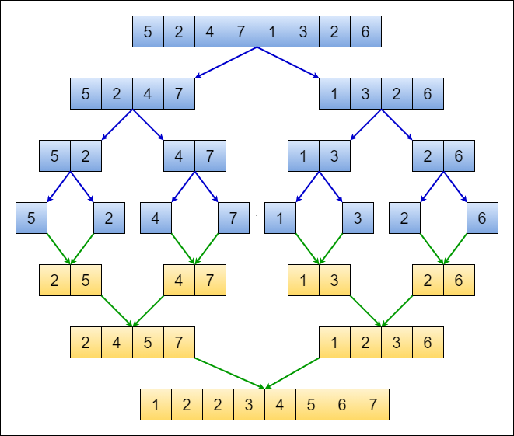
Merge Sort Example

Slide 32
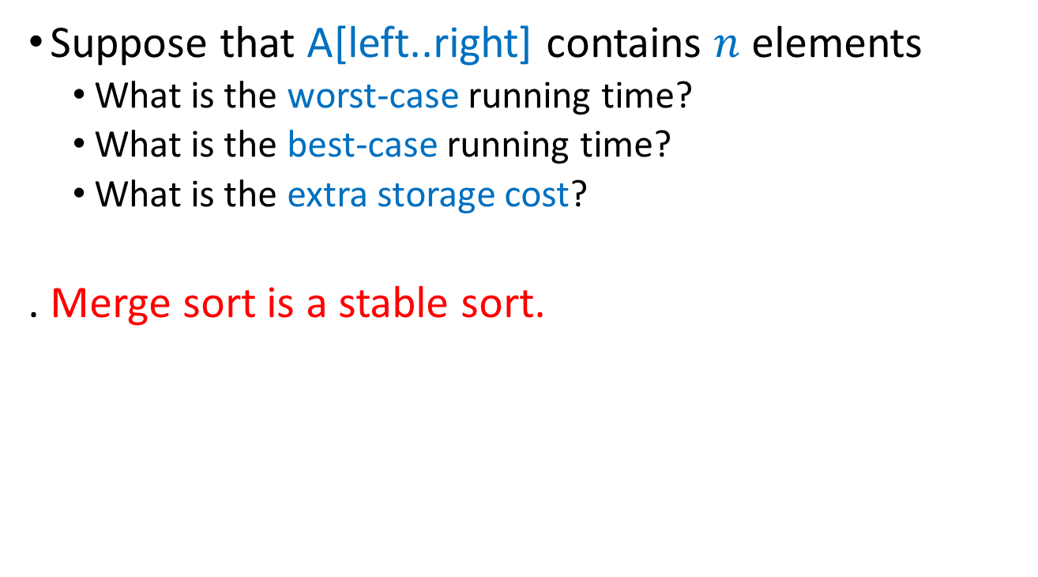
Discussion
Suppose that A[left..right] contains $n$ elements
What is the worst-case running time?
What is the best-case running time?
What is the extra storage cost?
. Merge sort is a stable sort.
Notes:
Best-case and Worst-case running time are the same: T(n) = 2T(n/2) + O(n)
Extra-storage cost: O(n)

Slide 33
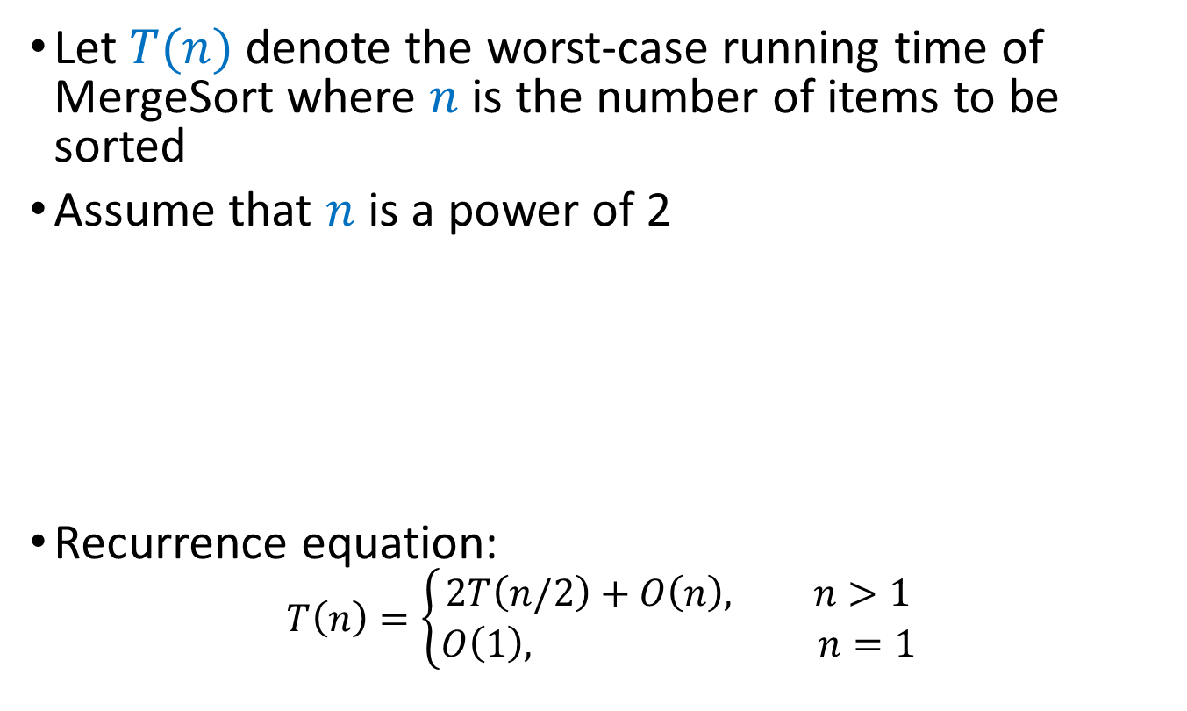
Analysis of Merge Sort
Let $T(n)$ denote the worst-case running time of MergeSort where $n$ is the number of items to be sorted
Assume that $n$ is a power of 2
Recurrence equation:
$$T\left(n\right)=\left\{\begin{aligned}2T\left(n/2\right)+O\left(n\right), n>1 \\ O\left(1\right), n=1\end{aligned}\right.$$
Divide: O(1) time
Conquer: 2T(n/2) time
Combine: O(n) time

Slide 34
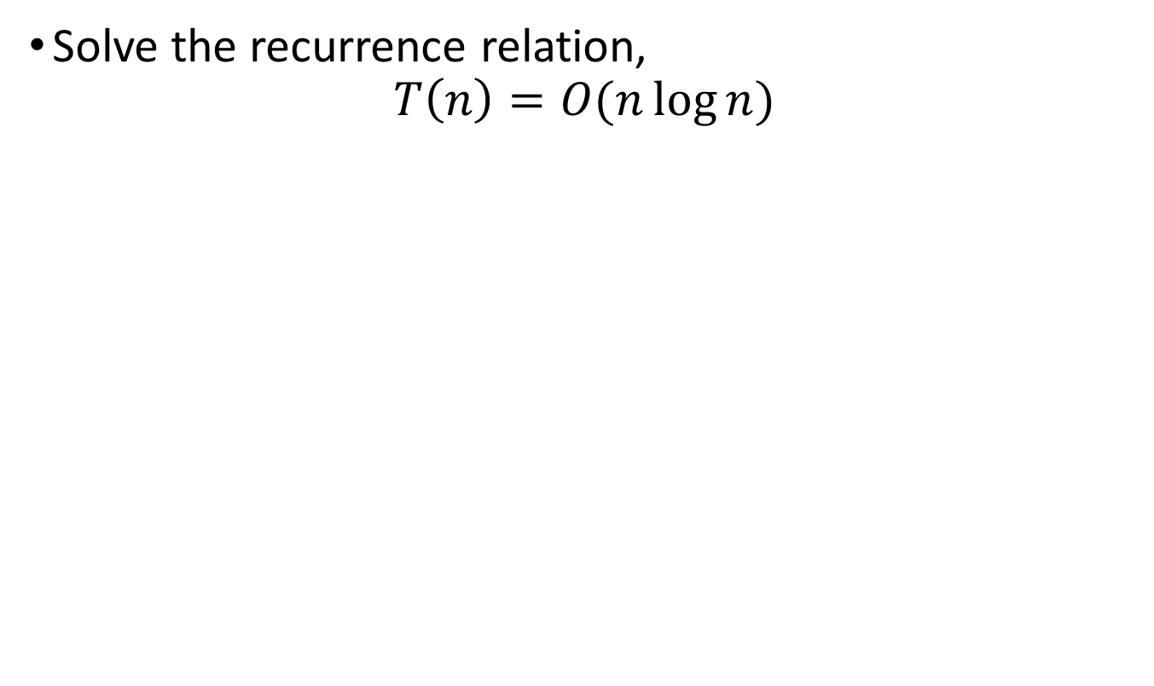
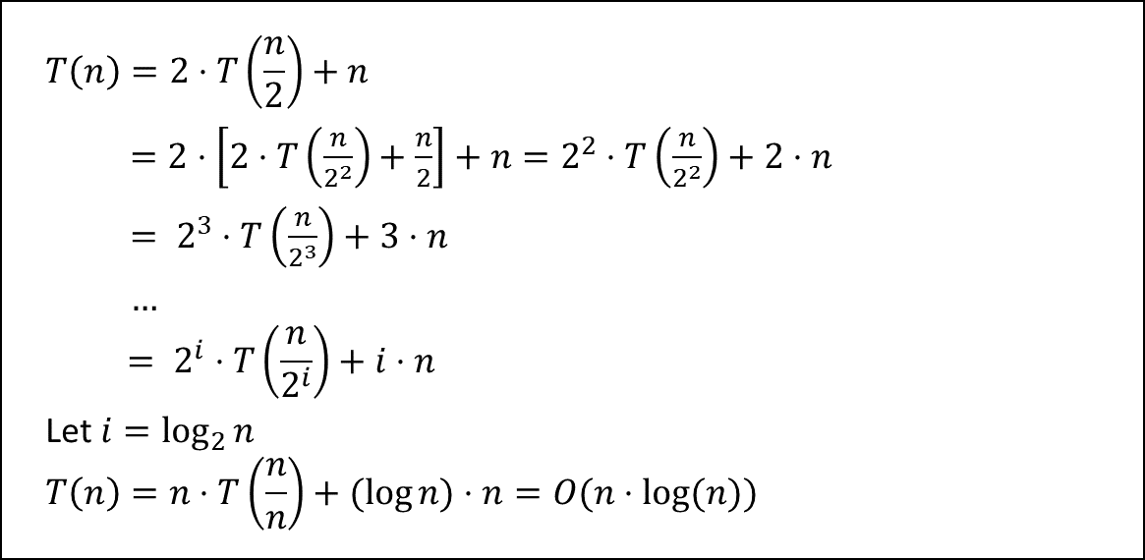
Analysis of Merge Sort
Solve the recurrence relation,
$$T\left(n\right)=O(n\log{n})$$
$$T\left(n\right)=2⋅T\left(\frac{n}{2}\right)+n$$
$=2⋅\left[2⋅T\left(\frac{n}{2^{2}}\right)+\frac{n}{2}\right]+n=2^{2}⋅T\left(\frac{n}{2^{2}}\right)+2⋅n$
$= 2^{3}⋅T\left(\frac{n}{2^{3}}\right)+3⋅n$
$…$
$$= 2^{i}⋅T\left(\frac{n}{2^{i}}\right)+i⋅n$$
Let $i=\log_{2}{n}$
$$T\left(n\right)=n⋅T\left(\frac{n}{n}\right)+(log{n)}⋅n=O(n⋅log⁡(n))$$

Slide 35
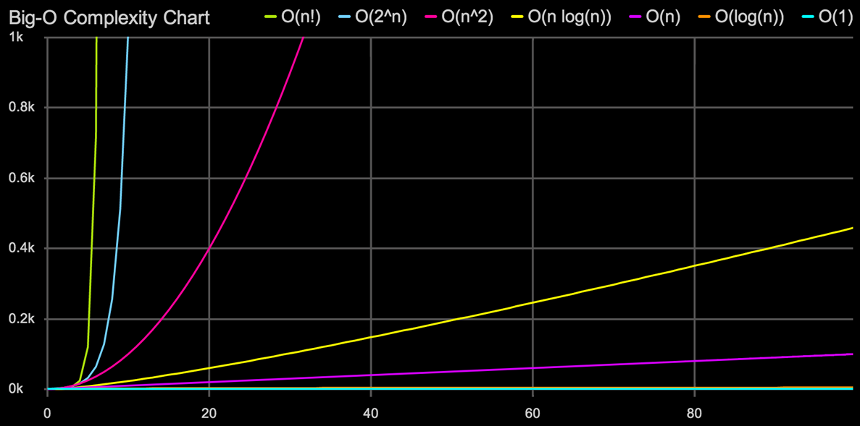
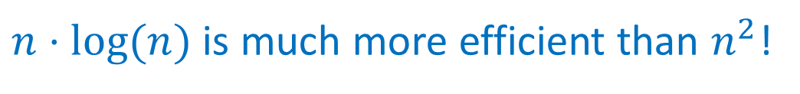
Analysis of Merge Sort
$n⋅log⁡(n)$ is much more efficient than $n^{2}$!

Slide 36
Divide and Conquer
If the problem is large, break it into sub-problems that are smaller in size but are similar in structure to the original problem, recursively solve the sub-problems, and finally combine the sub-solutions into a final solution that solves the original problem.

Slide 37
Three Phases of DC
Divide: top → bottom
Divide a problem into sub-problems
Conquer: bottom level
Solve the sub-problems recursively
If the sub-problems are small enough, solve them as base cases
Combine: bottom → top
Combine the solutions to the sub-problems into that of the original problem
Usually the key!

Slide 38
Divide-Conquer-Combine
problem
divide
subproblem
subproblem
conquer
solve
problem
solve
problem
solution to
subproblem
solution to
subproblem
combine
solution to problem

Slide 39
Divide-Conquer-Combine
problem
divide
subproblem
subproblem
divide
divide
subproblem
subproblem
subproblem
subproblem
divide
divide
divide
divide
subproblem
subproblem
subproblem
subproblem
subproblem
subproblem
subproblem
subproblem
solve
problem
solve
problem
solve
problem
solve
problem
solve
problem
solve
problem
solve
problem
solve
problem
solution to
subproblem
solution to
subproblem
solution to
subproblem
solution to
subproblem
solution to
subproblem
solution to
subproblem
solution to
subproblem
solution to
subproblem
combine
combine
combine
combine
solution to subproblem
solution to subproblem
solution to subproblem
solution to subproblem
combine
combine
solution to
subproblem
solution to
subproblem
combine
solution to
problem

Slide 40
Lab task
Submit Lab6.cpp to iSpace which includes at least three functions:
void InsertionSort(int *A, int n)
A is an array of integers and n is the size of A
Sort A using insertion sort
void MergeSort(int *A, int left, int right)
Sort array A[left..right] using merge sort
int main(void)
Let n be the size of the input array, for n=10 and n=10⁵ do the following operations
Generate an array, A1, consisting of n random integers
Note: Use malloc to claim an array
Generate another array A2 which is identical to A1
Sort A1 using InsertionSort() and A2 using MergeSort()
For input size n =10 , print the array before and after sorting for both functions
For input size n =10⁵ ,print elapsed time in milliseconds during which both functions run, respectively

